Slide 1
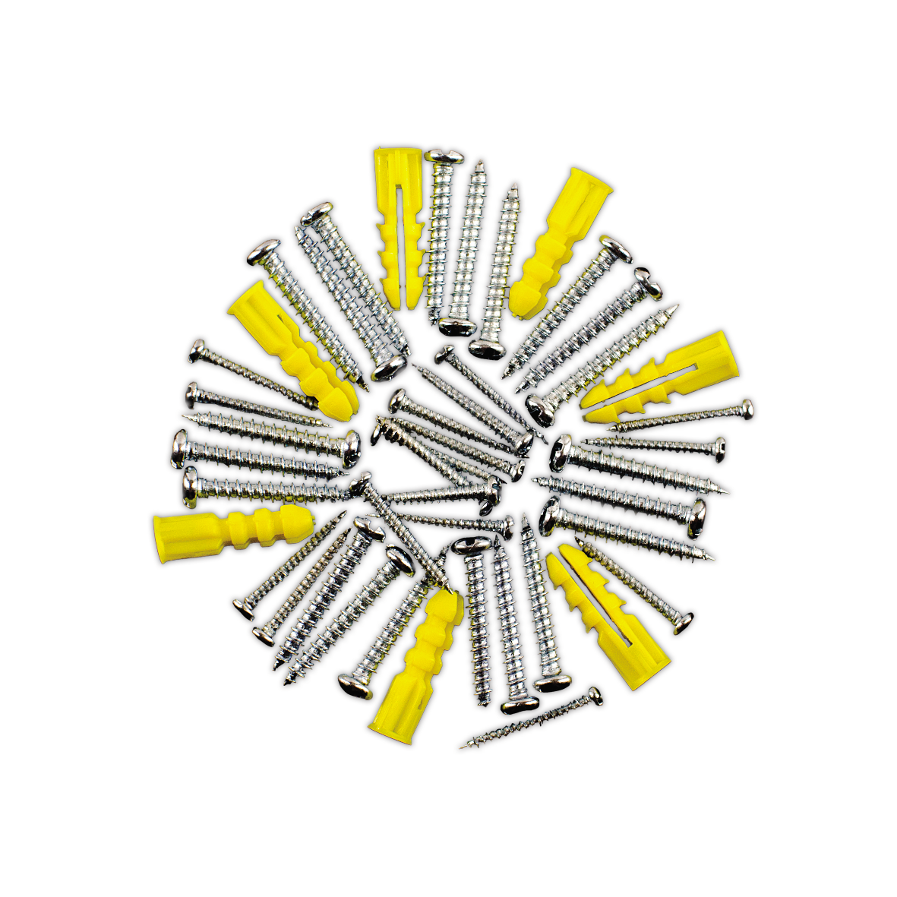
Microservices from the ground up
Systems Engineering

Slide 2
Agenda
Docker
Kubernetes
Terraform
Microservices
Container Orchestration
Cloud providers

Slide 3
Technology we‘re using today
Microsoft Dotnet (C#)
Docker
RabbitMQ
Kubernetes
Helm

Slide 4
Microservices
Order Pizza
Make Pizza
Focused purpose
Stateless
Elastic
Order pizza
Make pizza
Order pizza
Order pizza
Order pizza
Order pizza

Slide 5
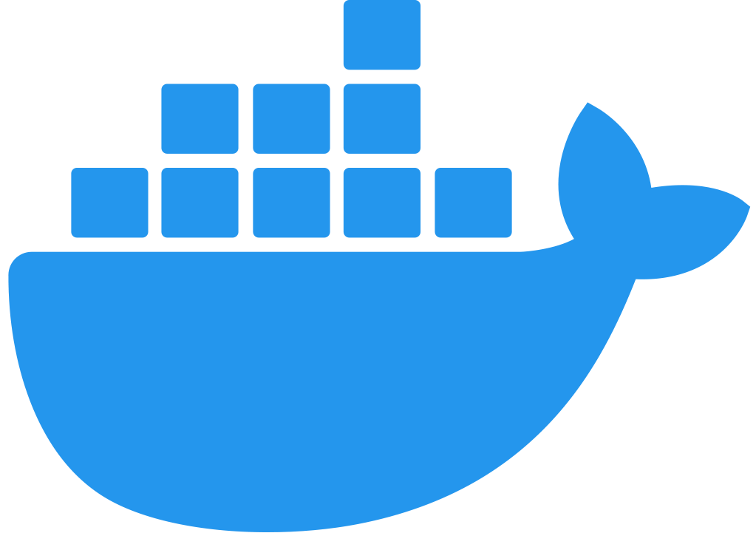
Docker Desktop – Dev machine
Api
Pod
HTTP
Client
AQMP
Worker
AQMP
Pod
RabbitMQ

Slide 6
Code Repo:
https://dev.azure.com/dk-consulting-deloitte/DK DC SE Developer Courses/_git/microservices-course

Slide 7
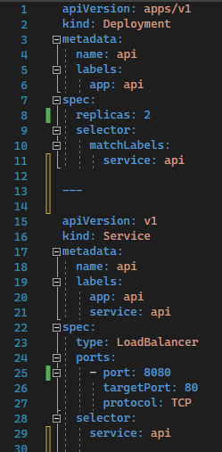
Kubernetes
Declarative vs Imperative
Deployment options
Horizontal vs Vertical scaling

Slide 8
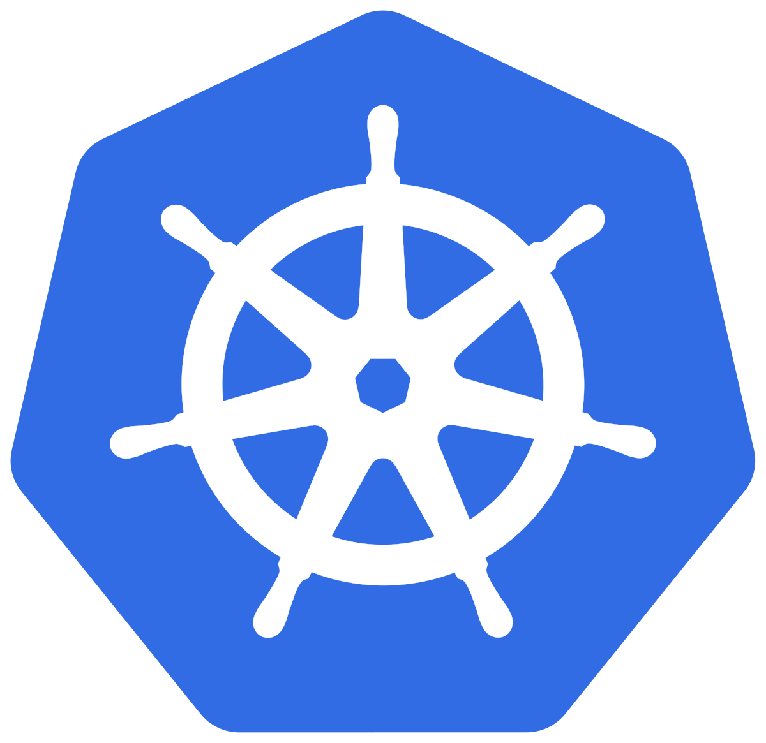
Kubernetes – Production
Kubernetes cluster
Worker
Pod
Api
Service
Worker
Pod
HTTP
Pod
Client
AQMP
Worker
AQMP
Pod
RabbitMQ

Slide 9
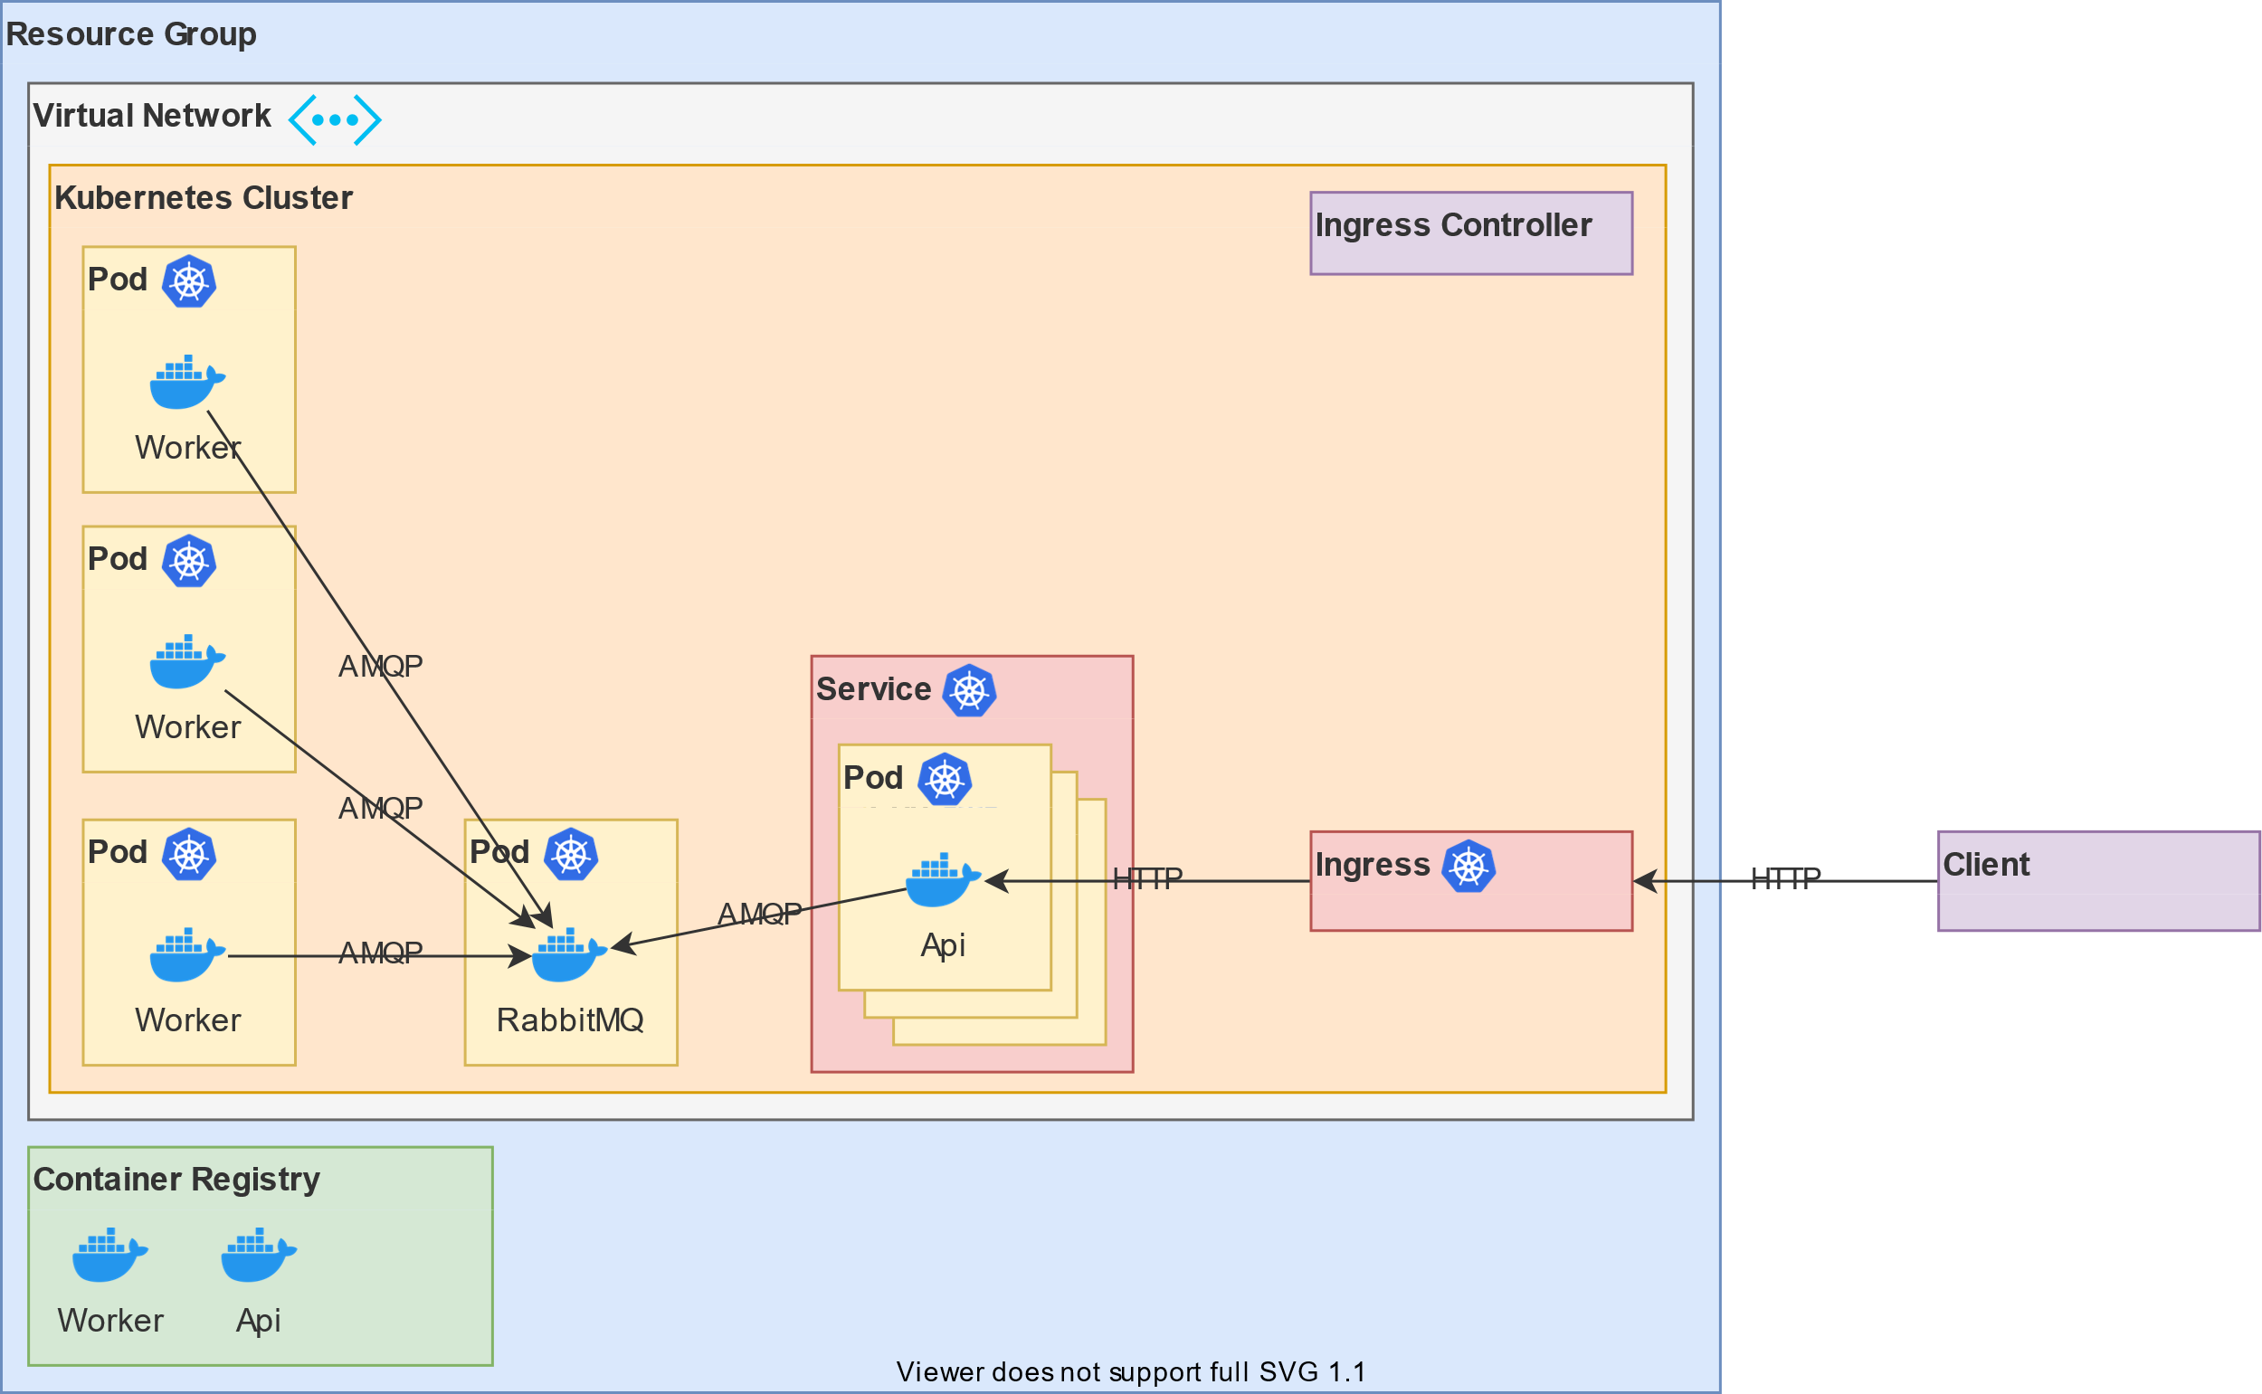
End result

Slide 10
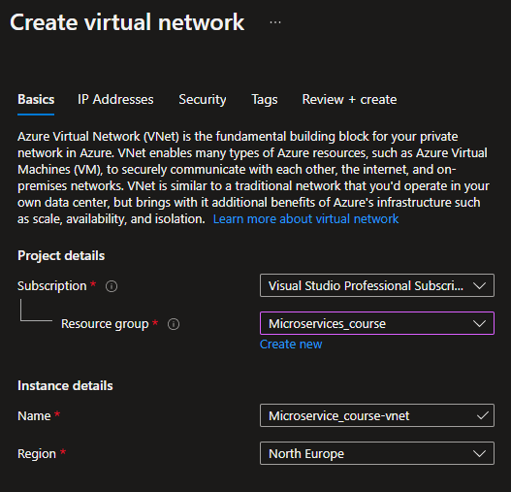
Terraform – Instead of using the GUI

Slide 11
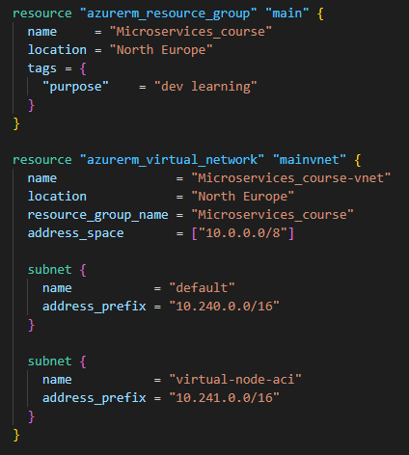
Terraform – Instead of using the GUI

Slide 12
Terraform – Instead of using the GUI

Slide 13
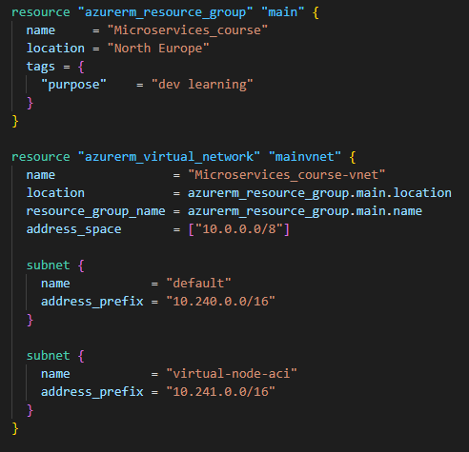
Terraform – Instead of using the GUI

Slide 14
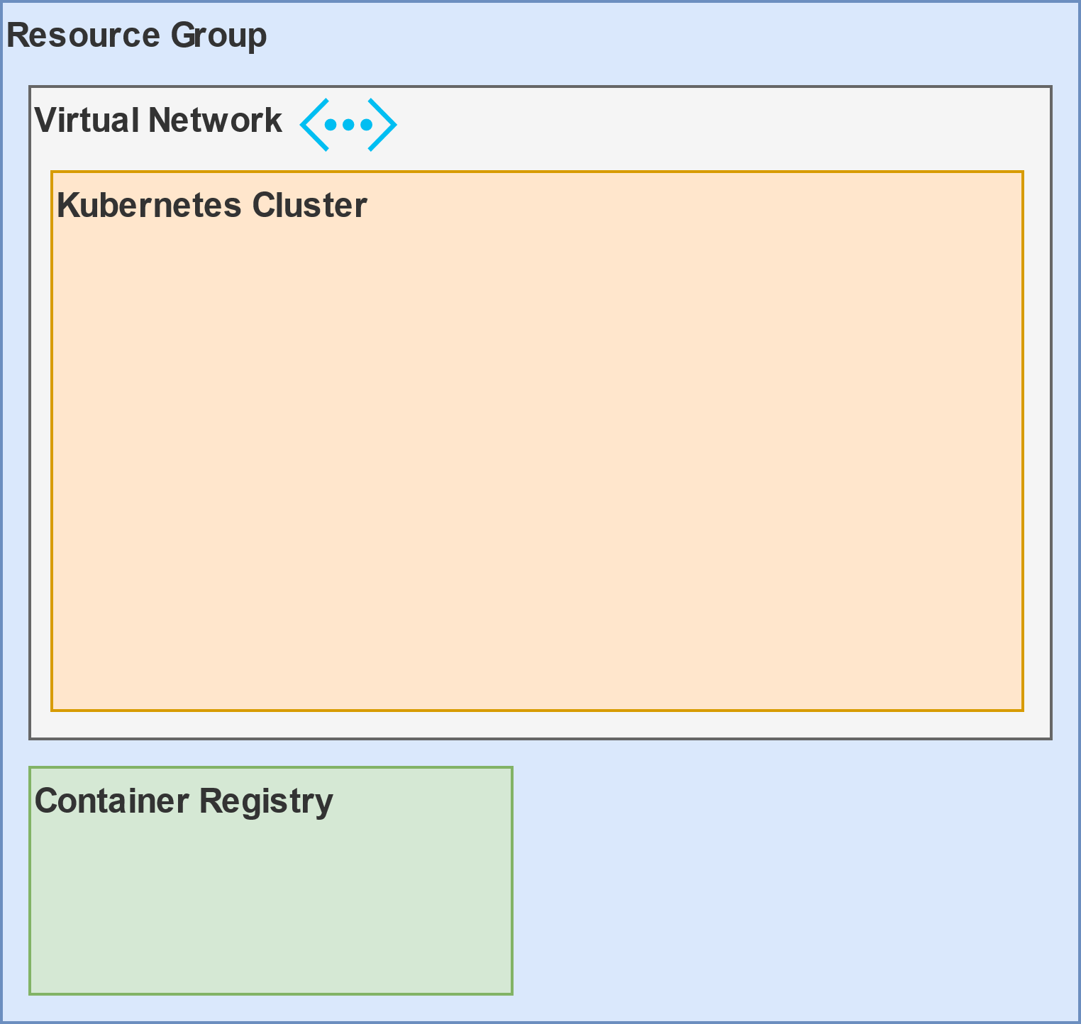
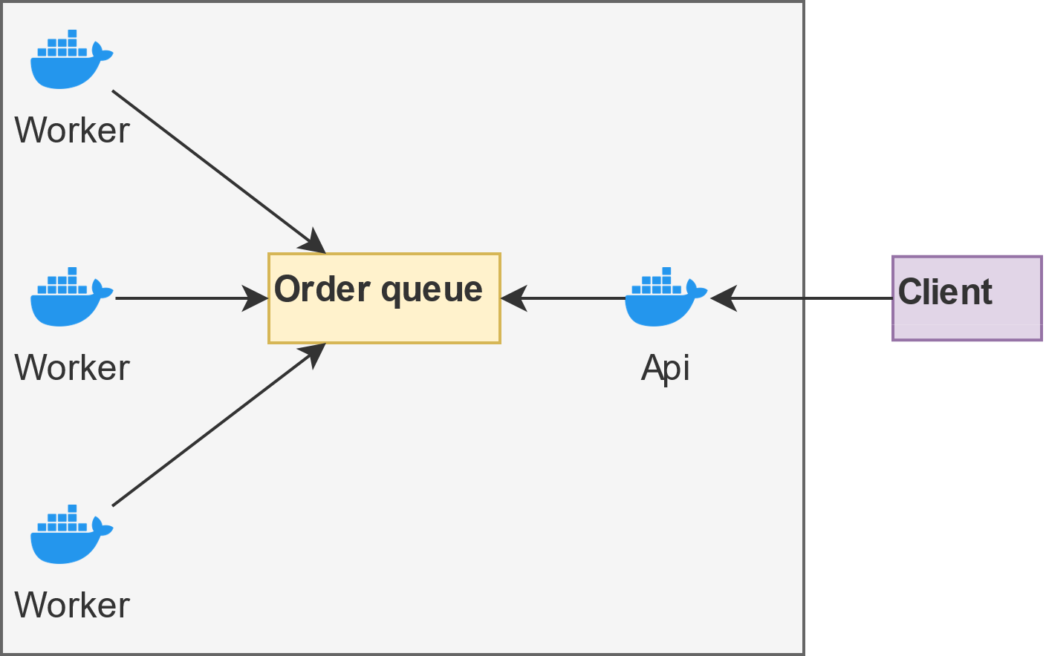
Terraform – Instead of using the GUI

